Slide 1
Qt Engine Edition
December 2016
Based on Qt 5.8
N.N.
N.N@company.com

Slide 2
Contents
Qt Libraries and Plugins | Custom Libraries Extending Qt with Plugins Plugin Development and Deployment
Qt Test | Creating a Unit Test Running Tests GUI Simulation Asynchronous Tests Benchmarking
Databases | Database Connection Driver Plugins SQL Queries Database Item Models Transactions
Multimedia | Playing Audio and Video Recording FM Radio

Slide 3
Contents
XML and JSON | Custom Libraries Low and High-Level Plugin APIs Plugin Development and Deploying Plugin Usage
Inter-Process Communication | Unit Testing GUI Simulation Asynchronous Tests Benchmarking
Multithreading | Database Drivers SQL Queries Query Models Transactions Performance
Multimedia | Playing Audio and Video Recording FM Radio

Slide 4
Contents
QtConcurrent | Concurrent Tasks Mapping and Filtering
Networking | TCP/UDP Sockets WebSockets SSL Sockets QNetworkAccessManager Requests and Replies DNS and Proxies Cookies
WebEngine | Essential Classes Handling Asynchronous Functions Exposing C++ Functions in WebEngine JavaScript Engine

Slide 5
Objectives
Learn…
...about the history of Qt
...about Qt's ecosystem
...a high-level overview of Qt
...how to create first hello world program
...build and run a program cross platform
...to use QtCreator IDE
...some practical tips for developing with Qt

Slide 6
Qt Libraries and Plugins

Slide 7
Contents
Custom Libraries
Extending Qt with Plugins
Plugin Development and Deployment

Slide 8
Objectives
Learn…
…creating and deploying libraries
…loading libraries and resolving symbols in libraries
…creating Qt plugins using high and low-level APIs

Slide 9
Libraries and Plugins
Application business logic, i.e. an engine can be implemented in a sharable library
Library
A file sharing data and code
Can be statically or dynamically linked
For static linking, Qt must be configured with –static option
Loaded at application startup-time
Can be loaded and unloaded dynamically
Plugin
A library, implementing an interface
Typically several different implementations of the same interface
Loaded dynamically, when needed
In static builds, plugins may be linked statically, but not loaded in run-time

Slide 10
Custom Libraries
In general, different platforms handle exporting symbols from a DLL in different ways
Some even require a special import declaration when clients of the DLL are compiled
Visibility of the symbols of a DLL might also depend on the compiler!
Once again, Qt hides all this behind a couple of macros:
Q_DECL_EXPORT – used with symbols when compiling a shared library
Q_DECL_IMPORT – used with symbols when compiling a client that uses the shared library
QtCreator project wizard creates this automatically
Qt uses private-implementation pattern to guarantee binary compatibility in libraries
Public class has a pointer to the private class
Private class contains all other data members

Slide 11
Library Deployment
DESTDIR .pro file variable defines, where the target file (library) is installed
Another option is to use make install and define files to be installed in INSTALLS variable
installFiles.files += $${HEADERS}
installFiles.path = $$[QT_INSTALL_HEADERS]
target.path = $$[QT_INSTALL_LIBS]
INSTALLS += target installFiles

Slide 12
Library Usage
The project, using the library, needs to know the location of library headers and binaries
The easiest way is to put all library-related definitions into either
a project include file (.pri) or
project feature file (mkspecs/features/*.prf)
Use include(someLibrary.pri) or CONFIG += someLibrary.prf to add definitions to your project
# .pro, .pri or .prf file
INCLUDEPATH += $$[QT_INSTALL_HEADERS]
LIBS += -L$$[QT_INSTALL_LIBS]
LIBS += -ldemoLibrary # No prefix or platform-specific suffix
ex-pimpl

Slide 13
Dynamic Loading and Unloading Libraries
QLibrary allows dynamic explicit library loading/unloading
QLibrary library("simpleLibrary"); // Or use absolute path
Overloaded constructor can be used to give the version number
fileName() returns the full library name, if the load was successful
resolve() resolves symbols, exported as C functions from the library
It also loads the library, if needed
extern "C” SHARED_EXPORT double pow(int a, int b) { }
QLibrary library("simpleLibrary");
typedef double (*PowerFunction)(int, int);
PowerFunction power = (PowerFunction) library.resolve("pow");
if (power)
qDebug() << power(5, -3);
else
qDebug() << "Library load failed:" << library.errorString();
ex-dynamic-loading

Slide 14
Extending Qt with Plugins
Define one or more interfaces
Create a plugin project using QtCreator
Implement the interfaces – Export the plugin with a JSON file, containing plugin meta data
Build and deploy the plugin
Load and use the plugin
ex-simple-plugin

Slide 15
Low and High-Level Plugin APIs
Low-level API
Allows implementing plugins to extend Qt applications
High-level API
Used to extend Qt itself with plugins
Developers need to implement Steps 2-4 only
Typically, Step 5 is implemented in plugin factory classes

Slide 16
Step 1: Define One or More Interfaces
Interface may be a class, containing pure virtual functions only, or it may be an abstract class
Classes should not have data members, though
Interfaces should derive from QObject
Interface implementation must derive from QObject any way
Q_DECLARE_INTERFACE() macro tells Qt (meta-object system) about the interface(s)
Q_DECLARE_INTERFACE(CoolInterface, “io.qt.CoolInterface”)
The second parameter is an identifier, which is used to register the class, implementing the interface
Class CoolInterface
{
public:
virtual QStringList method1() const = 0;
virtual QImage method2(const QString &string) = 0;
};
Q_DECLARE_INTERFACE(CoolInterface, “io.qt.CoolInterface”)

Slide 17
Step 2: Create a Plugin Project Using QtCreator
The default plugin base class (QGenericPlugin) is replaced with the plugin-specific base class
Add the plugin-specific function, which creates/registers the plugin object
If the low-level API is used, subclass QObject and your interface
Provide any function, e.g. just a constructor, which creates the plugin
Plugin entry point | Created type | Create function
QPlatformIntegrationPlugin | QPlatformIntegration | create(const Qstring & key)
QStylePlugin | QStyle | create(const Qstring & key)
QQmlExtensionPlugin | QQuickItem | void registerTypes(const char *uri)
QGenericPlugin | QObject | create(const Qstring & key)
Custom | Derived from QObject and custom interface | NA

Slide 18
Step 3: Implement the Interfaces
The plugin class must register the interface it implements
Only one interface can be registered in one class
Interface identifier (IID) must match the identifier, defined in the interface declaration (Step 1)
Some plugins require a JSON file, containing meta data about the plugin implementation
If the low-level API is used, the plugin class must report all interfaces it implements using Q_INTERFACES macro
Class CoolPlugin : public QObject, public CoolInterface
{
Q_OBJECT
Q_PLUGIN_METADATA(IID "io.qt.CoolInterface" FILE "coolInterface.json")
// org.qt-project.Qt.QStyleFactoryInterface IID for QStylePlugin
// org.qt-project.Qt.QQmlExtensionInterface IID for QQmlExtensionPlugin
// org.qt-project.Qt.QGenericPluginFactoryInterface IID for QGenericPlugin
Q_INTERFACES(CoolInterface) // Only needed in low-level API

Slide 19
Plugin Meta-Data
Plugin dependent
Provides information about the plugin
No need to load the plugin library to access this information
Plugin entry point | JSON data
QImageIOPlugin | Required, contains supported image formats and MIME types { "Keys": [ "jpg", "jpeg" ], "MimeTypes": [ "image/jpeg", "image/jpeg" ] }
QStylePlugin | Required, contains supported style names { "Keys": [ "mystyleplugin" ] }
QQmlExtensionPlugin | Not required, plugin info is read from the qmldir file
QGenericPlugin | Optional, may contain any custom data
Custom | Optional, may contain any custom data

Slide 20
Step 4: Build and Deploy the Plugin
The plugin project file should contain at least the following lines:
TEMPLATE = lib
CONFIG += plugin
The project file should define, where to place the plugin
Do so using one of qmake’s DESTDIR or INSTALL variables
# Installs target
DESTDIR = $$[QT_INSTALL_PLUGINS]/generic
# Installs any resources when make install executed
target.files += anyFileToBeInstalled
target.path = $$[QT_INSTALL_PLUGINS]/generic
INSTALLS += target

Slide 21
Step 5: Load and Use the Plugin High-Level API Plugins
Plugins exist in plugin-specific subfolder in $$[QT_INSTALL_PLUGINS]
E.g. plugins/styles
Additional search paths can be added with
QCoreApplication::addLibraryPath() or set by QCoreApplication::setLibraryPaths()
and queried with QLibraryInfo::location(QLibraryInfo::PluginsPath)
Plugins are loaded by factory classes
static QStyle *QStyleFactory::create(const QString &key);
static QObject *QGenericPluginFactory::create(const QString &key, const QString &specification);
Often plugin loading hidden from the developer
QML extension plugin loaded by the QML engine
QIOImagePlugin loaded by QImageReader, when QImage::load(const QString &file) called

Slide 22
Step 5: Load and Use the Plugin Low-Level API Plugins
Plugins must be loaded by the developer with QPluginLoader
Check, if the plugin is linked against the same Qt version as the loading application
Similar behavior to QLibrary except the plugin object is created with instance() function
No resolving needed
Q_FOREACH(const QString &fileName, pluginsDir.entryList(QDir::Files))
{
QPluginLoader loader(pluginsDir.absoluteFilePath(fileName));
QObject* plugin = loader.instance();
if (plugin) {
FilterInterface* filter = qobject_cast<FilterInterface*>(plugin);
if (filter) {…}
}
// Plugin unloaded from memory after all QPluginLoader objects of the same
// library destructed
}

Slide 23
Questions and Answers
What are the differences between a shared library and plugin?
Is it possible to load shared libraries without linking them using LIBS variable in the .pro file?
How plugins can be used in a statically linked program?
What are plugin low-level and high-level APIs?
How, when, and from which location does an application load plugins?

Slide 24
Summary
Application engines can be isolated from the GUI by implementing shared libraries or plugins
Shared libraries share data and functionality
Plugins provide interface implementations
Shared libraries are typically loaded, when an application starts
Possible to load and unload libraries and resolve symbols dynamically
Plugins are loaded when requested
Exported symbols are defined by the interface
Programs search for plugins in pre-defined locations
If high-level API is used, a Qt class typically takes care of loading plugins
If low-level API is used, plugins are loaded by the developer

Slide 25
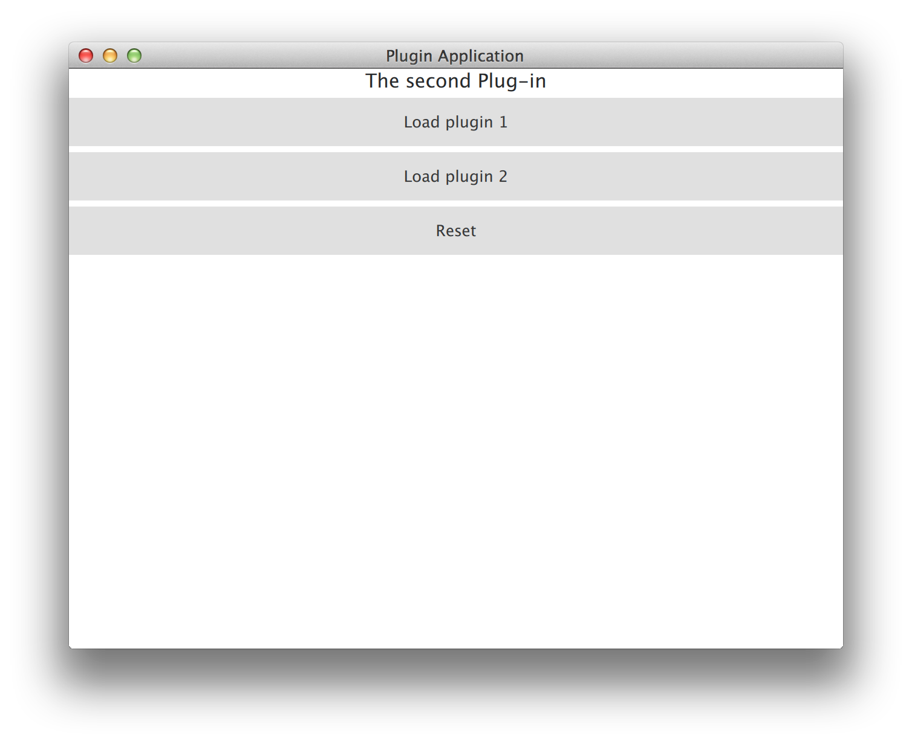
Lab – Custom Plugin
Define a custom interface
Implement one or more plugins, implementing the interface
Complete the skeleton program, loading the plugin
Further implementation details in readme.txt
lab-plugins

Slide 26
Qt Test

Slide 27
Contents
Creating a Unit Test
Running Tests
GUI Simulation
Asynchronous Tests
Benchmarking

Slide 28
Objectives
Learn…
…writing and executing unit tests with Qt Test
…testing signals and slots
…benchmarking code blocks

Slide 29
Qt Test Module Features
Lightweight | Consists of about 6000 lines of code and 60 exported symbols
Self-contained | Requires only a few symbols from the Qt Core library for non-GUI testing
Rapid testing | Needs no special test-runners; no special registration for tests
Data-driven testing | A test can be executed multiple times with different test data
Basic GUI testing | Offers functionality for mouse, touch, and keyboard simulation
IDE friendly | Outputs messages that can be interpreted by Visual Studio and KDevelop
Thread-safety | The error reporting is thread safe and atomic
Type-safety | Extensive use of templates prevent errors introduced by implicit type casting
Easily extendable | Custom types can easily be added to the test data and test output

Slide 30
Creating a Unit Test
A test project wizard provided in Qt Creator
Create two subprojects using SUBDIRS
The actual project
An adjacent test project
Example project .pro file
SUBDIRS = \
interestingProject.pro \
interestingProject_tst.pro
Write test cases, while you develop the code
Test-driven development
Do not mix test code and project code

Slide 31
Test Cases
class ExTestTest : public QObject
{
Q_OBJECT
public:
ExTestTest(); private:
// The two optional functions below may be private slots as well
void initTestCase(); // Called before any test has been executed
void cleanupTestCase(); // Called after all the test have been executed
// Test case functions must be private slots
// They are executed in the declaration order
private Q_SLOTS:
void testCase1();
void testCase2();
// Two optional test case functions executed differently
init(); // Called before each test case void
void cleanup(); // Called after each test case
};
ex-trivial-unit-test

Slide 32
Test Project
Macros QTEST_MAIN and QTEST_APPLESS_MAIN define the main() function
Instantiate the test class and execute all the test cases
All the test case functions are run on that same instance
Macros suggest that each test class is compiled and linked to one executable

Slide 33
Running Tests Command Line Options
Output format
txt
csv
xml
xunitxml
Verbosity
silent – failure and fatal errors only
v1- start of each test function
v2 – each QVERIFY/QCOMPARE/QTEST
Testing options
functions – list test functions
datatags – list data tags
eventdelay – default delay in mouse and keyboard simulation in ms
nocrashhandler – useful for debugging crahses
./test
./test testCase1
./test testCase1:testData1

Slide 34
Test Results
Test cases may be
Skipped, if a tested feature is not present in the current configuration
QSKIP(“This test requires feature X”)
or black listed, if test cases are skipped in some platform, OS, toolchain, distribution or architecture
android
ios
winrt
[testSomethingNotPresentOnMobilePlatforms]
PASS : MyDataTest::initTestCase()
PASS : MyDataTest::myTestCase
PASS : MyDataTest::cleanupTestCase()
Totals: 4 passed, 0 failed, 0 skipped, 0 blacklisted
********* Finished testing of MyDataTest *********

Slide 35
Notes
If an exception is thrown, rest of the test functions are not executed
May produce misleading results
There may be more test functions skipped than reported
You can combine more than just one test class together
Do not use QTEST_MAIN or QTEST_APPLESS_MAIN
There is no new instance for each invocation of a test function
As you may have used to have in other test frameworks
Executable returns (QTEST_MAIN/QTEST_APPLESS_MAIN) a fail count by default, which is useful for scripts

Slide 36
Test Macros
Several useful macros available to write test cases
Defined in QTest name space
VERIFY(condition)
QTRY_VERIFY(condition)
QTRY_VERIFY_WITH_TIMEOUT(condition, timeout)
VERIFY2(condition, message)
An additional message is recorded into the test log if the condition is not true
QTRY_VERIFY2_WITH_TIMEOUT(condition, message, timeout)
QCOMPARE(actual, expected)
Records the actual and expected values into the test log if they do not match
QTRY_COMPARE(actual, expected)
QFAIL(message)
Fails the test case, supposed to be used within the logic of a test function
QWARN(message)
Can be used to record a message to the test log

Slide 37
Enabling Verbose Output
QCOMPARE macro uses QTest::toString() functions to output verbose data of different argument types in case the comparison fails
Useful to add support for relevant custom types by adding specializations of overloads
namespace MyNamespace {
char *toString(const MyPoint &point)
{
// bring QTest::toString overloads into scope:
using QTest::toString;
// delegate char* handling to QTest::toString(QByteArray):
return toString("MyPoint(" +
QByteArray::number(point.x()) + ", " +
QByteArray::number(point.y()) + ')');
}
}

Slide 38
Data-Centric Test Case
Possible to define data sets (tables) for tests
Data defined in testCase_data() functions
#include <QtTest/QTest>
class MyDataTest : public QObject
{
Q_OBJECT
private slots:
void myTestCase_data();
void myTestCase();
}
ex-data-test

Slide 39
Providing Test Data
Add columns with arguments and expected results
Add rows of data
The argument of the newRow() function defines a tag, which can be used to include a row in the test
By default all rows will be included
void MyDataTest::myTestCase_data()
{
// test data table with two columns
QTest::addColumn<int>("integer_input");
QTest::addColumn<QString>("result");
// test data
QTest::newRow("1st row") << 1 << “yahoo”;
QTest::newRow("2nd row") << 2 << “hello”;
QTest::newRow("3rd") << 3 << “yeah”;
}

Slide 40
Feeding Test Data for Test Case
Test function is called multiple times (number of rows)
Test function produces a single pass/fail result
void MyDataTest::myTestCase()
{
QFETCH(int, integer_input);
QFETCH(QString, result);
QCOMPARE(myTestedFunction(integer_input),result);
}

Slide 41
QTest GUI Testing Support
QTest class can be used to:
Simulate key events
Simulate key presses: Up and Down
Simulate mouse events: Click and Move
Simulate mouse presses: Up and Down
Simulate sequences of touch events
Check the current test function or data to initialize or cleanup something
Convert values of various types into strings

Slide 42
Simulate Key/Mouse/Touch Events
void MyTest::init()
{
_tested = new QLineEdit("default");
}
void MyTest::testcase()
{
QString defaultValue("default");
QString input("abc");
QTest::keyClicks(_tested, input);
// mouseClick(), mouseDClick(), mouseMove(), touchEvent()
QString result(_tested->text());
QString expected(defaultValue + input);
QCOMPARE(result, expected);
}
ex-keyinput

Slide 43
Testing Asynchronous Functions
No mock objects exist in QTestLib
Order and quantity of calls of slots/functions need to be recorded
QSignalSpy
The challenge is not to fall out the test slot function before verifying signals emitted by the tested class
QTest::qWait()?
How long to wait?
QSignalSpy::wait()
Starts an event loop
Waits until a signal or timeout occurs

Slide 44
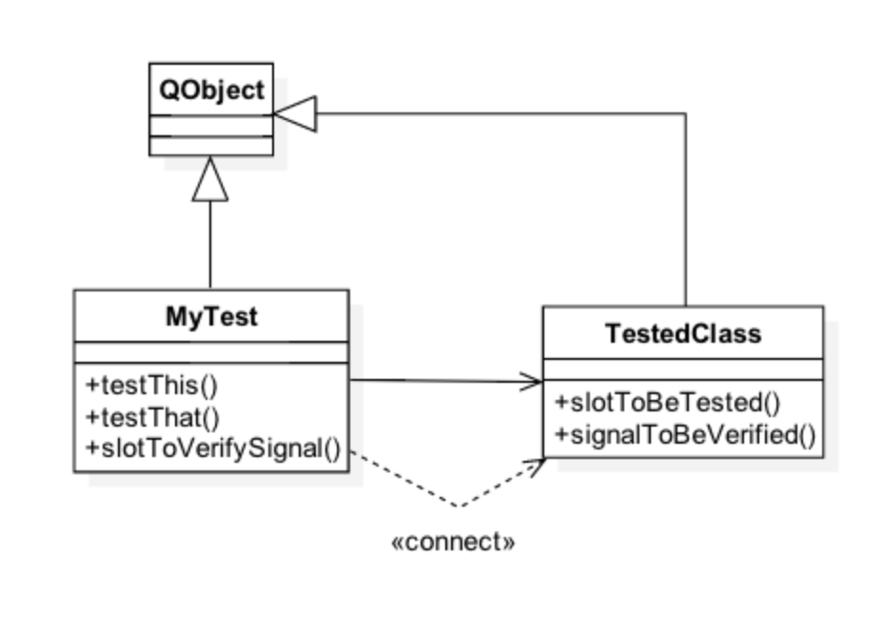
Asynchronous Signals
A signal can be emitted asynchronously after a tested slot is called
Test code needs to connect to that signal to receive it
The connected slot needs to verify the signal

Slide 45
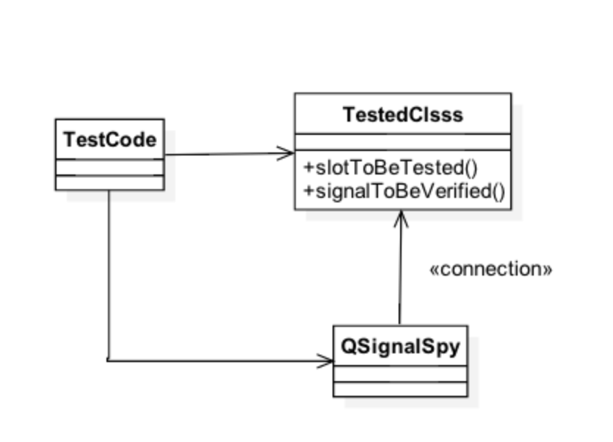
QSignalSpy
Can be used to record calls of a single signal
Records the values of the call

Slide 46
Example Test with QSignalSpy
void MyTest::testStart()
{
MyTimer timer;
QSignalSpy spy(&timer, &MyTimer::ownTimerTimeout);
QVERIFY(spy.isValid()); // valid signal
QVERIFY(spy.isEmpty()); // no calls, precondition
const unsigned long int Period = 2;
timer.ownStartTimer(Period);
QVERIFY(spy.wait(Period * 10));
const int result = spy.count();
QCOMPARE(result, 1); // one call expected
QList<QVariant> theCall = spy.takeFirst();
QVERIFY(theCall.isEmpty()); // no parameters
}
ex-signalspy

Slide 47
Recorded Calls
QSignalSpy is QList<QList<QVariant > >
All parameters of calls can be accessed and verified through QList
Values are stored as QVariants
QVariant provides converter functions
For example, QVariant::toInt()

Slide 48
QBENCHMARK Macro
Simple to use
Code block may be iterated
Affects to the test design and implementation
Several measurement back-ends possible
Wall time, CPU tick count, valgrind/callgrind, event count
Availability depends on the platform
Sometimes more straightforward to use QTime::elapsed() function

Slide 49
Benchmarking
QBENCHMARK { // or QBENCHMARK_ONCE
… code to be measured …
}
PASS : Container_perfTest::initTestCase()
PASS : Container_perfTest::testCase1()
RESULT : Container_perfTest::testCase1():
0.50 msecs per iteration (total: 64, iterations: 128)
PASS : Container_perfTest::testCase2()
RESULT : Container_perfTest::testCase2():
0.54 msecs per iteration (total: 70, iterations: 128)

Slide 50
Questions and Answers
What kind of tests can be written with Qt Test?
How tests are executed?
Name at least five macros, which can be used in writing tests. How do these macros work?
Explain differences between QTest::qWait() and QSignalSpy::wait(). Which one would you prefer in testing signals?
What should you take into account, when benchmarking code with QBENCHMARK?

Slide 51
Summary
Qt Test allows you to write unit tests for your classes
Qt Test provides a framework to implement and execute test functions
Several macros, such as QVERIFY, QCOMPARE, QSKIP, QFETCH, QBENCHMARK, are available to implement test cases
Test data can be provided in a table format
Data rows can be selected using the command line options
GUI events can be simulated in tests
Emitted signals and their parameters can be tested with QSignalSpy

Slide 52
Lab – Benchmarking Iterators
You are provided with a console program, using Java-style and STL-style iterators on an associative container
Create a test project with test functions, which benchmark the iterators
Java-style iterator
STL-style const iterator
Java-style mutable iterator
STLstyle non-const iterator
Q_FOREACH vs. range-based loop
You need to reset the iterator, if the benchmarked code is executed more than once
lab-benchmarking-iterators

Slide 53
Item Models

Slide 54
Contents
Item Models

Slide 55
Objectives

Slide 56
Databases

Slide 57
Contents
Database Connection
Driver Plugins
SQL Queries
Database Item Models
Transactions

Slide 58
Objectives

Slide 59
Qt Database Module
Qt contains cross-platform and database-independent SQL APIs
All database-specific code for accessing the database is hidden behind a special driver plug-in
In order to use the SQL support, add QT += sql to your .pro file

Slide 60
Database Connection
Provides an interface to a database using database-specific drivers
Any number of connections to one or more databases supported
QSqlDatabase::addDatabase(const QString &type, const QString &name) returns an object for the database connection
Type defines the driver to be used
Connection is identified by a name – using an existing connection name replaces the old one
Connection may only be used in the thread, where it was created
If no connection name is given, the default connection is used in SQL queries later on
QSqlDatabase::connection(const QString &name) returns a connection object, provided the connection has been previously added

Slide 61
Supported Connection Types
Due to license incompatibilities with the GPL, not all of the plugins are provided with open source versions of Qt
Driver type | Description
QDB2 QIBASE QMYSQL | IBM DB2, v7.1 and higher Borland Interbase Driver MySQL Driver
QOCI QODBC QPSQL | Oracle Call Interface Driver ODBC Driver PostgreSQL v7.3 and higher
QSQLITE QSQLITE2 QTDS | SQLite version 3 or above SQLite version 2 Obsolete, superseded by ODBC

Slide 62
Connecting to a Database
Connecting options can be provided with connection member functions
setDatabaseName() // May be a name, Oracle TNS name, MS Access .mdb file name
setHostName()
setUserName()
setConnectOptions()
setPassword()
Before any queries can be done, the database connection is opened using open()
Returns true if a connection could be established or false, if something went wrong

Slide 63
Connection Example
QSqlDatabase db = QSqlDatabase::addDatabase("QMYSQL");
db.setHostName("bigblue");
db.setDatabaseName("flightdb");
db.setUserName("acarlson");
db.setPassword("1uTbSbAs");
bool ok = db.open();
if (!ok)
qFatal() << "Error opening database: “ << db.lastError();

Slide 64
Connection Options
Database-specific options
Read only access
SSL connection required
Login timeout
Set with semicolon-separated key=value pairs
MySQL
db.setConnectOptions("CLIENT_SSL=1;CLIENT_IGNORE_SPACE=1");
ODBC
db.setConnectOptions("SQL_ATTR_ACCESS_MODE=SQL_MODE_READ_ONLY)

Slide 65
Error Handling
In case QSqlDatabase::open() fails, error messages and error codes can be obtained from the object returned by the method QSqlDatabase::lastError()
The error object contains, among others, the following methods:
driverText(),
databaseText(),
text()(a concatenation of the previous two functions),
type()(driver error number), and
number()(database error number)
Note that the text returned from databaseText() is most likely not localized

Slide 66
Database Tables, Records, and Features
Function tables() returns the list of tables and views
Function primaryIndex() returns a table’s primary index
To get meta-information about table’s fields, call record(const QString &tableName)
Returns QSqlRecord, containing table fields in undefined order
To check, whether the database driver supports some feature, use hasFeature() function
hasFeature(QSqlDriver::QuerySize)
Available drivers can be queried using drivers()

Slide 67
Driver Plug-ins
For non-supported database types custom driver plugins can be implemented
Not necessary to implement the plugin at all
QSqlDatabase::registerSqlDriver(“CUSTOMDRIVER”,
new QSqlDriverCreator<CustomDriver>);
Derive a class from QSqlDriver and implement the pure virtual functions
Provides concrete implementation of QSqlDatabase functions
Derive a class from QSqlResult and implement the pure virtual functions
Provides concrete implementation of QSqlQuery functions
Notice that the source code for existing drivers is provided in any Qt release – use those as examples!
Plenty of more information available in Qt Assistant, as well

Slide 68
Driver Plug-ins
class QSQLiteDriverPlugin : public QSqlDriverPlugin
{
Q_OBJECT Q_PLUGIN_METADATA(IID "org.qt-project.Qt.QSqlDriverFactoryInterface"
FILE "sqlite.json") public:
QSQLiteDriverPlugin(); QSqlDriver* create(const QString &) Q_DECL_OVERRIDE;
}; class QSQLiteDriver : public QSqlDriver
{
Q_OBJECT
public:
explicit QSQLiteDriver(QObject *parent = 0);
bool hasFeature(DriverFeature f) const Q_DECL_OVERRIDE;
bool open(const QString &db, const QString &user, const QString &password,
const QString &host, int port, const QString &connOpts)
// sqlite3_open_v2(file, sqlite3Struct, openMode);
QSqlResult *createResult()
QStringList tables(QSql::TableType) const Q_DECL_OVERRIDE; QSqlIndex primaryIndex(const QString &table) const Q_DECL_OVERRIDE;
qtbase/src/plugins/sqldrivers/sqlite

Slide 69
QSqlQuery
Wrapper to QSqlResult in the driver
Supports any query, supported by the driver
An optional argument can be given to the constructor, specifying which database to use
Run a query by calling exec()
size() reports how many rows were matched by a select query
I -1 if the number of rows can not be determined
numRowsAffected() tells how many rows were affected by a non-select query, say, an update query
QSqlQuery query;
if (!query.exec("SELECT name FROM author"))
// ...

Slide 70
SQL Queries
In case of a select statement, the result can be iterated over using QSqlQuery::next()
This method returns true as long as there are more records available
The value of the records is fetched using QSqlQuery::value(int), which returns a QVariant
For navigation you can use:
QSqlQuery::first(),
QSqlQuery::last(),
QSqlQuery::prev()
QSqlQuery::seek(int)
QSqlQuery::lastError() can be used to query for error messages
QSqlQuery query("SELECT country FROM artist");
while (query.next()) {
QString country = query.value(0).toString();
doSomething(country);
}
ex-query

Slide 71
Prepared Queries
May speed up inserting a large number of records
If the database does not support prepared queries Qt will translate the query into an ordinary query
Two kinds of prepared queries:
named bindings
positional bindings

Slide 72
Bindings
// Named bindings
QSqlQuery query;
query.prepare("INSERT INTO employee (id, name, salary) VALUES (:id, :name, :salary)");
query.bindValue(":id", 1001);
query.bindValue(":name", ”Employee 1");
query.bindValue(":salary", 10000000);
query.exec();
// Positional bindings
QSqlQuery query;
query.prepare("INSERT INTO employee (id, name, salary) VALUES (?, ?, ?)");
query.addBindValue(1002);
query.addBindValue(”Employee 2");
query.addBindValue(10000001);
query.exec();

Slide 73
Database Item Models
QSqlQueryModel wraps a QSqlQuery in a QAbstractItemModel
The result set of the query can be used with the model/view framework
The titles displayed in views are the column names from the database
Can be changed using QSqlQueryModel::setHeaderData()
QSqlTableModel wraps a single table in a model, and does therefore allow editing the items
Create an instance of QSqlTableModel, and call setTable() specifying the table to use
Optionally call setFilter() specifying a WHERE part of a SQL query
Optionally call setSort() specifying column number and sort direction
Call select() to execute the query
QSqlRelationalTableModel is QSqlTableModel subclass with a foreign key support
Demo: ex-query-model

Slide 74
QSqlTableModel vs. QAbstractItemModel
Possible to access the table programmatically using the methods of QAbstractItemModel
QSqlTableModel adds a few methods for convenience
record(), setRecord() and insertRecord() all work with instances of QSqlRecord
All refer to rows in the table rather than QModelIndexes
QSqlRecord is a simple container for records containing methods like
setValue(int index, QVariant value),
setValue(QString name, QVariant value), and similar
QVariant value(...) methods

Slide 75
QSqlTableModel
for (int row = 0; row < model->rowCount(); ++row) {
QSqlRecord record = model->record(row);
double price = record.value("price").toDouble();
price *= 1.1;
record.setValue("price", price);
model->setRecord(row, record);
}
model->submitAll();

Slide 76
Commit
Using setEditStrategy() it is possible to specify when changes made in the GUI should be committed to the database
Edit strategies
OnFieldChange – Data will be saved as soon as you start editing a new cell
OnRowChange – Data will be saved when you start editing a new record (changes can be discarded by calling revert())
OnManualSubmit – Data will only be saved when you call submitAll() (changes can be discarded with revertAll())
Be careful with OnFieldChange:
Performance can drop significantly compared to using the other editing strategies
If you modify a primary key, the record might slip through your fingers while you are trying to fill it

Slide 77
Editable Queries
Without modifications QSqlQueryModel is read only, while QSqlTableModel only works on a single table
To be able to edit the result of an arbitrary query, override
QAbstractItemModel::setData() to update the data yourself, and
QAbstractItemModel::flags() to specify that the table is editable
ex-editable-query

Slide 78
Transactions
You start a transaction using
QSqlDatabase::transaction(), and end it using
QSqlDatabase::commit() or
QSqlDatabase::rollback()
The above methods return true if the action succeeded
Transaction requires support from the database – check for this using
QSqlDriver::hasFeature(QSqlDriver::Transactions)

Slide 79
Lab – Bookstore
Author table in upper view
Book table in lower view
Only books from current author shown
Follow these steps:
Setup the author table
Use current item change
Setup book table with QSqlQueryModel
Rerun the query
Provide edit support for both tables
Optional
Support add/delete rows
lab-bookstore

Slide 80
Summary
Qt database system is based on the model/view framework with three layers
Database technology -based drivers
Model classes
View classes
Qt has support to make SQL queries to the database
Intuitive Qt-style APIs provided for composing the queries

Slide 81
Multimedia

Slide 82
Contents
Playing Audio and Video
Recording
FM Radio

Slide 83
QtMultimedia Features
Audio device access
QAudioDeviceInfo
QAudioInput with volume control
QAudioOutput with volume control
Audio format
QAudioFormat
Low latency sound effects
QSound – plays .wav files
QSoundEffect
Video surface
QVideoSurfaceFormat
QAbstractVideoSurface
Video data
QVideoFrame
Radio
QRadioTuner
QRadioData
3D positional audio
Qt audio engine with many QML types

Slide 84
Qt Multimedia Module – Essential Classes

Slide 85
Audio and Video Playback Using Media Player
Instantiate QMediaPlayer and QMediaPlayList
The play list may use any model derived from QAbstractItemModel
Set the playlist to the player
Create and set the video output for the player
QVideoWidget
QGraphicsVideoItem
QAbstractVideoSurface
A continuous stream of identically formatted video frames
Select the item to be played
Play list current index
Add the UI controls and
Connect to the player slots
Start, stop, pause
Start the playback
player = new QMediaPlayer;
playlist = new QMediaPlaylist(player);
playlist->addMedia(QUrl("http://.../song1.mp3"));
playlist->addMedia(QUrl("http://.../song2.mp3"));
// optionally setVideoWidget for the player to
// render video
playlist->setCurrentIndex(1);
player->play();
Demo: ex-avplayer

Slide 86
Audio and Video Recording
QAudioRecorder allows recording and compressing audio data
QMediaRecorder allows recording video
Set the source in the constructor (a camera or a radio tuner)
Set audio settings as above
Start recording
audioRecorder = new QAudioRecorder;
QAudioEncoderSettings audioSettings;
audioSettings.setCodec("audio/amr"); audioSettings.setQuality(QMultimedia::HighQuality);
audioRecorder->setEncodingSettings(audioSettings);
audioRecorder->setOutputLocation(QUrl::fromLocalFile("test.amr"));
audioRecorder->record();

Slide 87
Other Audio Classes
QSoundEffect
Low latency WAV format sound effects
Volume, mute, and number of loops may be controlled
QAudioProbe
Monitor played or recorded audio data
Any media object may be used as a source
QAudioOutput and QAudioInput
Raw audio data output and input
Available HW determines what audio input and outputs are available
Qt Audio Engine
QML module for providing 3D positional audio playback and content management
Wave files are organized into discrete Sound instances, which are grouped and controlled using categories

Slide 88
Accessing Low Level Video Frames
Useful when accessing barcodes or applying fancy effects to the frames
Set the video output of the media player to your custom surface
class MyVideoSurface : public QAbstractVideoSurface
{
QList<QVideoFrame::PixelFormat> supportedPixelFormats(
QAbstractVideoBuffer::HandleType handleType =
QAbstractVideoBuffer::NoHandle) const {
Q_UNUSED(handleType);
// Return the formats you will support
return QList<QVideoFrame::PixelFormat>() << QVideoFrame::Format_RGB565;
}
bool present(const QVideoFrame &frame)
{
Q_UNUSED(frame);
// Handle the frame and do your processing return true;
}

Slide 89
FM Radio
Radio tuner + access to RDS
QRadioTuner
Media object
Frequency control
Stereo mode control
Provides access to QRadioData
QRadioData
Station name
Station id
Radio text
radio = new QRadioTuner;
connect(radio, SIGNAL(frequencyChanged(int)), this,
SLOT(freqChanged(int)));
if (radio->isBandSupported(QRadioTuner::FM)) {
radio->setBand(QRadioTuner::FM);
radio->setFrequency(yourRadioStationFrequency);
radio->setVolume(100);
radio->start();
}

Slide 90
XML and JSON

Slide 91
Contents
XML Parsing
JSON

Slide 92
QXmlStreamReader
SAX has the disadvantage that control is in the engine, which calls the user’s callbacks
This makes it hard to create a recursive descent parser
When using QXmlStreamReader it is the application that requests the next token to be read using
TokenType QXmlStreamReader::readNext()/readNextStartElement()
Test the type of token using methods like:
isStartDocument(), isStartElement(), isEndElement(), isCharacters()
Fetch data from a token using
name() (returning the name of the element),
text(), or
readElementText() (which returns everything till the matching end token as text)
Attributes are read using attributes()

Slide 93
QXmlStreamReader – Errors
If an error occur during parsing, readNext() will return EndDocument, which also means that atEnd() returns true
Test if an error exists using hasError() and read the error using error()
You can also signal an error yourself using raiseError(QString msg)

Slide 94
QXmlStreamReader – Providing XML
You can provide the XML document for parsing either as a QString, a QIODevice (a file, a socket, . . . ) or as a QByteArray
More data can be provided later using addData()
If the data ends prematurely (not all data received over a socket, for example) then readNext() will return
PrematureEndOfDocumentError, resulting in atEnd() returning false
It is possible to resume once data is available

Slide 95
QXmlStreamWriter
The class QXmlStreamWriter allows you to write XML in a streaming fashion, using high level functions
Data are written using methods like writeStartDocument(), writeStartElement(), writeEndElement(), writeAttribute(), writeCharacters()
Specify the device to write to using setDevice(QIODevice*)
To get human readable XML generated (e.g. new lines in place), call setAutoFormatting(true)
Demo: ex-xmlstreamwriter

Slide 96
JSON
Format to encode object data in JS
Six basic types
Bool, double, string, array [], object {}, null
{
“key1”: “value1”,
“key2”: “value2”,
“key3”: {
“key4”, “value4”,
“key5”: “value5”
},
etc.

Slide 97
JSON Processing
C++ API to parse, modify, and save JSON data
Speed optimized binary format that is directly memory map-able and very fast to access
QJsonDocument::fromJson() / toJson()
Parses UTF-8 encoded JSON document to the binary format and back
The document contains an array or an object
QJsonArray/QJsonObject classes provide API to parse and modify the content
An object contains key-value pairs, where a value can be an array, object or any of the basic types
The easiest way to parse arrays or objects is to use iterators
QJsonObject jsonObject(document.object());
if (jsonObject.contains(“key1")) {
QJsonValue value(jsonObject.take(“key1"));

Slide 98
void parseObject(const QJsonObject &object, QXmlStreamWriter &writer)
{
QStringList keys = object.keys();
Q_FOREACH(const QString &key, keys) {
writer.writeStartElement(key);
parseValue(object.value(key), writer);
writer.writeEndElement();
}
}
void parseValue(const QJsonValue &value, QXmlStreamWriter &writer)
{
if (value.isArray())
parseArray(value.toArray(), writer);
else if (value.isObject())
parseObject(value.toObject(), writer);
else if (value.isBool()) {
if (value.toBool())
writer.writeCharacters("true");
else
writer.writeCharacters("false");
}
// and so on for double and undefined types
}

Slide 99
Lab – Reading and Writing Xml Keys
KeyEngine class allows storing key-value pairs
Your task to write XML read/write backends
XML Format shall be:
<?xml version="1.0" encoding="UTF-8"?>
<keys version="1.0”>
<item key="Key-0">Value-0</item>
<item key="Key-1">Value-1</item>
…
<item key="Key-9">Value-9</item>
</keys>
Lab: lab/xmlkeys

Slide 100
Inter-Process Communication

Slide 101
Contents
Running Processes
Shared Memory with Qt
QtDBus – Qt Bindings to D-Bus

Slide 102
Processes
QProcess allows launching external programs and communicating with them
Asynchronously or synchronously
After the process has been created, it enters the Starting state
After the process is started, it enters Running state and emits started() signal
Process may be started several times (platform dependent behavior)
QObject *parent;
...
QString program = "./helloworld";
QStringList arguments;
arguments << "-style" << "motif";
QProcess *myProcess = new QProcess(parent);
myProcess->start(program, arguments);

Slide 103
Process Invocation – Synchronous
Wait until the child process has started (or finished)
waitForStarted() returns when the started() signal has been emitted
waitForFinished() returns when the finished() signal has been emitted
Wait until the child process writes or when you write to the child (QIODevice members)
waitForReadyRead() returns when data is available for reading on the current channel
waitForBytesWritten() returns when certain (unspecified) amount of data has been written
Calling any of these methods in the main (GUI) thread will freeze your user interface
Use multithreading

Slide 104
Process Invocation – Synchronous and Asynchronous
A simple way to execute a process, start it, and wait for the termination is to use execute()
Does not allow processing the child input or sending output to the child
Use QProcess::startDetached() instead if you want the child process to detach from the current one
This method will not wait for termination, and the child process will not be terminated when the current process terminates (“fire and forget”)
QStringList arguments;
arguments << "Argument1" << "Argument2";
QProcess::execute("do_it_now", arguments);
// won’t get here until do_it_now terminates

Slide 105
Inter-Process Communication
As straightforward as accessing the files
Thanks to QIODevice
Write process’s standard input using write() and read from the standard output using read(), readLine(), readAll(), getChar()
QProcess gzip;
gzip.start("gzip", QStringList() << "-c");
if (!gzip.waitForStarted())
return false;
gzip.write(“Hello World!");
gzip.closeWriteChannel();
if (!gzip.waitForFinished())
return false;
QByteArray result = gzip.readAll();

Slide 106
Inter-Process Communication
QSharedMemory
Reference count object, can be opened by any process
Simple memcpy() used to read/write to the process
Servers (QCoreApplication instances)
QLocalSocket used (local loop TCP socket)
QCop (Qt Communication protocol) – prior Qt5
Available only in Qt for embedded Linux
DBus
Extends signal/slot mechanism between processes
DBus protocol must be supported by the platform
Service Framework
Part of Qt4 mobility APIs
Platform-dependent functionality
Message queues, pipes

Slide 107
Shared Memory
Use QSharedMemory
Works between processes and threads
Processes recognize the piece of shared memory using a key (QString)
Process attach and detach to shared memory using the key
Do not de-allocate shared memory buffer
Reference count – will be freed, when all QSharedMemory objects referencing it have been deleted
Mutual exclusion is taken care by the developer
Use lock() and unlock()

Slide 108
Shared Memory Example
QSharedMemory mem(QString(“thekey”), 0);
// Create a new/old shared memory
mem.create(SIZE);
mem.lock(); // uses QSystemSemaphore internally
char *to = (char*)mem.data();
const char *from = buffer.data();
memcpy(to, from, qMin(mem.size(), SIZE));
mem.unlock();

Slide 109
D-Bus
D-Bus itself is a server
Message (remote procedure call) –based communication between processes
Applications (service providers) send messages to D-Bus, which routes the messages to one or more receiver
Abstract
D-Bus does not define, which mechanism (e.g. sockets) actually transfers the messages
Two kinds of daemons
System-wide singleton (for system messages, such as signal strength, battery level)
User session –specific (between applications)

Slide 110
D-Bus Concepts – 1(2)
Object paths
A mechanism to locate, which native object (GObject, Java Object, Qt QObject) provides a service
E.g. company/services/serviceX
Each object may have method and signal members
Methods are (remote procedures) operations which can be invoked on an object with optional input and (possibly several) output values
Signals are broadcast from an object to all its observers (may contain data)
E.g. doSomething, notify
Member group is mapped to an interface
Mapped to Java interface or C++ pure virtual class
Identified as com.company.InterfaceName

Slide 111
D-Bus Concepts – 2(2)
Bus names
D-Bus daemon assigns a unique connection name for each connection from applications
After a name is mapped to an application, the application owns that name
Applications may ask to own well-known names, e.g. com.theqtcompany.MessageEditor
Addresses
Specify where a server will listen and where a client will connect
Possibly, your service is a server daemon to which applications send messages

Slide 112
D-Bus, The Qt Way
QtDBus allows to call methods of D-Bus objects
QtDBus allows to connect signals and slots between D-Bus objects
Since it uses the meta object information, it is not necessary to know the interface of the remote object
QtDBus takes care of mapping Qt data types to the defined D-Bus data types
QtDBus resolves object names to interfaces with the correct signals and slots

Slide 113
Calling Methods on D-Bus Objects in the Client Side
In QtDBus, the slots on the remote object can be called as if the object was local
To call a method on the remote object, QDBusInterface has to be retrieved for it first
The method can then be called using QDBusInterface::call or QDBusInterface::asyncCall()
Example:
QDBusReply<QString> reply = iface.call("echo", "hi”);
calls the slot named echo on the remote object with argument “hi”
The interface object may be created from D-Bus XML interface using qdbusxml2cpp –p tool
Generates public slots and signals in the interface class
May be directly accessed from the client

Slide 114
Mapping between QtDBus and D-Bus Data Types
QtDBus needs to map Qt data types to types known by D-Bus
All arguments marshalling is taken care of by Qt
Supported data types: uchar, bool, short, ushort, int, uint, qlonglong, qulonglong, double, QString, QStringList, QByteArray, and special D-Bus types
Compound types can be formed as arrays, structs, and maps
To use custom data types,
declare the type using Q_DECLARE_METATYPE(),
and register it using qDBusRegisterMetaType()

Slide 115
Important Server Side Methods
QDBusConnection::sessionBus()/systemBus(): access to the bus objects
QDBusConnection::registerService(): register a service (“host part”)
QDBusConnection::registerObject(): register an object (“file part”)
QDBusInterface constructor constructs a QObject that represents the signals and slots of the remote object

Slide 116
Qt D-Bus Server Implementation
Create a service object
Often created with qdbusxml2cpp –a tool
qdbusxml2cpp –a myAdaptor.h: myInterace.xml
qdbusxml2cpp –i myAdaptor.h –a :myAdaptor.cpp myInterace.xml
Maps D-Bus messages to signals and slots
new serviceAdaptor(myServerObject);
Create a D-Bus session
if (!QDBusConnection::sessionBus().isConnected()) { /* Handle error */ }
if (!QDBusConnection::sessionBus().registerService(SERVICE_NAME)) { }
Register the service
QDBusConnection::sessionBus().registerObject("/", &myServerObject, QDBusConnection::ExportAllSlots);
The exposed signals and slots can be restricted by the remote object (QDBusConnection::RegisterOptions())

Slide 117
Multithreading

Slide 118
Contents
Qt Threading Model
Re-entrant and Thread-safe Classes
Thread Affinity
Multithreading
Synchronization
Mutual Exclusion
Thread Storage
Inter-Thread Communication
QRunnable
Thread Pool

Slide 119
Qt Threading Model
A simple application has typically one process and one thread
QtWebEngine uses several processes
Network access manager uses threading
Image loading, QML component loading and compilation may take place in a background thread
QtQuick 2 renderer may run in its own thread
Basic recommendations
Avoid doing anything blocking in the main (GUI) thread
Always use a background thread for blocking functionality (or use non-blocking functions, if available)
Try to minimize the number of events, the GUI thread needs to handle
Animation, running in the GUI thread, suffer from a delay longer than 16 ms (60 FPS)
Process
Heap
Thread
Stack
Event
loop
Thread
Stack
Thread
Stack
Event
loop

Slide 120
Re-entrant and Thread-safe Classes
Re-entrant class
All member functions are re-entrant
Re-entrant class may be used in multiple threads, but each thread has its own instance of the class
Many classes are re-entrant (among 750 classes in Qt libraries)
Most value-based (implicit shared) classes (not QPixmap),
Many QObjects, no widgets though
Rich text processing classes – some of them even provide clone() function
QSvgGenerator and QSvgRenderer
You may need to explicitly create a copy of a re-entrant object for another thread
Thread-safe class
All member functions are thread-safe
The class instance may be shared by multiple threads – mutual exclusion needed
Very few Qt classes are thread-safe
Some functions are, for example QObject::connect(), signal emission
Mutex, semapahore, wait condition

Slide 121
Limitations
Database connections and queries using that connection work in a single thread only
QImage is re-entrant – each thread painting to QImage at the same time must paint to its own instance
Event-based classes
You cannot start and stop QTimer object in two separate threads
You cannot use QTcpSocket object returned by QTcpServer (listens to client connection requests) in another thread
Avoid accessing a QObject in the wrong thread context
If your QObject is handling an event, while you call its function, it may crash
Especially, do not delete the object in the middle of event handling from another thread
Use deferred deletion
All the data must be protected – avoid in the GUI thread

Slide 122
Thread Affinity
Simply a member in QObject pointing to a thread an object belongs to – not memory management
Note that parent and children cannot belong to separate threads
Creating an object (QObject!) in one thread and calling its functions from another thread is not guaranteed to work
The problem is that event handing in the local thread and calling functions from another thread may crash the object data
Simple solution
Change the affinity
Instead of direct calls, use signals and slots
More complicated and heavier solution
Make your class thread safe
Use event-driven objects in a single thread
Timer, sockets

Slide 123
Multithreading – QThread
Think of QThread as a manager object
Priority, execution, stack size
Each QObject belongs to one (or zero) thread, who should not be the owner of QObject
Constructor is executed in the caller thread
Everything created in the constructor belong to the creator thread
A parent and children cannot belong to separate threads
To receive queued signals (events) in a thread, you have start the event loop in that thread
Default implementation of QThread::run() does nothing else but calls exec()to start the event loop
No need to sub-class QThread – just change the QObject thread affinity using QObject::moveToThread(QThread *)

Slide 124
Thread Programming – 1(2)
Java model:
To create a new thread, instantiate QThread
Create a worker object
Set the worker’s affinity to the thread
Then call start() on your instance
Threads have priorities that you can specify as an optional parameter to start(), or change with setPriority()
IdlePriority, …, TimeCriticalPriority
Priority may be “inherited” from the parent thread
idealThreadCount() tells you the ideal amount of threads based on numbers of physical and logical CPU’s
To wait for a thread to finish, use QThread::wait()or finished() signal
You can also specify a maximum number of milliseconds to wait for a thread to finish

Slide 125
Thread Programming – 2(2)
QThread::isFinished() and QThread::isRunning() provide information about the execution of the thread
You can also connect to the signals started(), finished(), and terminated()
A thread can stop execution temporarily using the following functions
QThread::sleep(),
QThread::msleep(),
QThread::usleep()
Simple QTimer should be preferred – Qt is event-based

Slide 126
Thread Example
QThread *thread = new QThread(); // Possibly allocated in the stack
Worker *worker = new Worker(); // Possibly allocated in the stack
connect(worker, &Worker::error, errorHandler, &ErrorHander::errorString);
connect(thread, &QThread::started, worker, &Worker::process);
worker->moveToThread(thread);
// Worker knows when it is finished
connect(worker, &Worker::finished, thread, &QThread::quit);
// Or someone else requests for interruption
// QThread::requestInterruption(); // Since Qt 5.2
connect(worker, &Worker::finished, worker, &Worker::deleteLater);
connect(thread, &QThread::finished, thread, &QThread::deleteLater);
thread->start();

Slide 127
Mutual Exclusion
Mutexes are implemented by the class QMutex
The two important methods are lock() and unlock()
You can try locking a mutex using tryLock()
If the lock was obtained it will return true, otherwise it will return false right away, rather than waiting for the mutex
tryLock(int timeout) will wait timeout milliseconds before giving up on getting the lock

Slide 128
Thread Synchronization
QMutex
Protects access to a shared resource
Recursive mutex since Qt 5.0
QReadWriteLock
Increases concurrency compared to QMutex
Multiple reads allowed
QSemaphore QSystemSemaphore
Protects a certain number of identical resources
QWaitCondition
Several threads may wait for a condition
It is possible to wake up one thread randomly or all the threads
One thread waits, another thread wakes it up
Hint! The system semaphore is a kernel object, but other locks are simple counters protected with atomic operations. So use a system semaphore only, if you need to synchronize threads running in separate processes

Slide 129
Mutex Rules
When you lock a mutex you must, of course, unlock it again!
This can be troublesome if you want to lock a mutex at the entrance of a function, and unlock it at exit—your function can possibly return from many places (code like “if (...) return false;”)
If you are using exceptions (or libraries that do), every statement can be an exit point from your function!
QMutexLocker will help you here, simply put the following code right before you need the lock, and it will lock the mutex for the duration of the block:
QMutexLocker lock(&myMutex);

Slide 130
Example on Thread Synchronization
QMutex sharedMutex;
class Simple
{
public:
Simple() { n = 0; }
void increment() { QMutexLocker locker(&sharedMutex); n+=2; }
void decrement() { QMutexLocker locker(&sharedMutex); n-=2; }
int value() const { QMutexLocker locker(&sharedMutex); return n; }
private:
int n;
};

Slide 131
Wait Condition
QWaitCondition::wait() lets a thread wait for a certain event
You can specify a maximum waiting time
You must pass a locked QMutex (no QReadWriteLock, though), to atomically go from locked state to wait state
The mutex will be automatically locked before the thread is woken
Wake one (random) thread waiting on a wait condition with QWaitCondition::wakeOne() and all waiting threads with QWaitCondition::wakeAll()
forever {
mutex.lock();
keyPressed.wait(&mutex);
do_something();
mutex.unlock();
}
Demo: ex-waitConditions

Slide 132
ITC
ITC problem: How to pass data and notifications from one thread to another?
QWaitCondition plus mutex-protected thread-global data goes a long way, but does not work when the main thread is involved, because the UI would freeze while the main thread is waiting for a condition.
Posting events with QCoreApplication::postEvent()
Cross-thread signal/slot communication

Slide 133
Queued Connections
Thread safe!
No risk of calling a function in QObject, while it is in the middle of event handling
Serialize signal arguments into an event object, posts the event, handles the event, re-creates the argument objects in the receiver thread using object introspection, and calls the slot
Require (run-time name resolution requires) that your
Custom typedefs are registered using qRegisterMetaType<CustomType>(“CustomType”) or
Custom classes are register using qMetaTypeId<MyType>()
SIGNAL(someSignal(CustomType)) // Copies the arg synchronously, before creating an
// event
SIGNAL(someSignal(const CustomType &)) // For sharing assignable type
SIGNAL(someSignal(CustomType *)) // Typically, used for QObjects
SIGNAL(someSignal(QSharedPointer<CustomType>)) // Preferred for pointer sharing
Demo: ex-queuedconnections

Slide 134
Meta-Object Usage
Possible to call slots anywhere using the meta object
Make sure not to have direct calls, unless you need to do so
For example, accessing objects in the signaling thread context
Only string-based version exist
QMetaObject::invokeMethod(observerObject, "someSlot", Qt::QueuedConnection,
Q_RETURN_ARG(int, retValue), Q_ARG(int, 42));

Slide 135
QRunnable Interface
QRunnable can be used instead of QThread
Light-weight way of implementing multithreading
No need to manually create/delete a new thread object – threads are re-cycled
A free thread is picked from QThreadPool
If no free thread exists, the task is queued
class HelloWorldTask : public QRunnable
{
// Note: QRunnable does not have a base class!
void run() {
qDebug() << "Hello world from thread" << QThread::currentThread();
}
}
HelloWorldTask *hello = new HelloWorldTask();
// QThreadPool takes ownership and deletes 'hello' automatically
QThreadPool::globalInstance()->start(hello);

Slide 136
QThread versus QRunnable
QThread derives from QObject
Signals and slots
QObject is “heavy”
Cost of creating a thread
QRunnable has no base class
Light-weight
Runs on any free thread
Designed to be used QThreadPool
By default deleted by the thread pool

Slide 137
Thread Pool
Manages threads
One global thread pool in the application
Possible to set max thread number
A thread may be reserved for external usage
Releases threads, if threads are idle for a defined time period
Possible to clear() the queue or cancel() one or more tasks
QThreadPool *threadPool = new QThreadPool;
// threadPool->waitForDone();
…
void somewhereElse()
{
MyTask *task = new MyTask;
threadPool->start(task); // also tryStart() function
}
Demo: ex-concurrenttasks

Slide 138
Thread Reservation
QThreadPool::reserveThread() // releaseThread();
Reservation always increases the number of active threads
May be larger than maximum number of threads
It is also possible to yield execution of a thread to other threads by releasing a thread before reserving it
The thread will wait reserveThread() to be called
QThread has also a static yieldCurrentThread() function

Slide 139
Summary
Qt processes and threads are wrappers on POSIX APIs
Native processes/threads always used
If supported in the platform, programs may create and kill processes and use several methods to share data between processes
Implementations are platform dependent and e.g. QSharedMemory does not work in the same way in all platforms
QThread is a Java-like API to multithreading
QRunnable interface is similar to Java Runnable
Qt runnable objects re-use threads using QThreadPool
No performance penalty of creating and deleting threads

Slide 140
QtConcurrent

Slide 141
Contents
Concurrent Tasks
Mapping and Filtering

Slide 142
QtConcurrent
QtConcurrent is a high-level framework for parallel algorithms
Add-on module in Qt 5.0
Work is automatically distributed over an optimal number of threads, determined at runtime
Possible to execute concurrent tasks QtConcurrent::run()
Data in a container may be changed or filtered
map() (transform() in STL speak) or filter() (copy_if())
Manipulate data in-place (map(), filter())
Copy data into a new container (mapped(), filtered())
Optionally, use reduction (mappedReduced(), filteredReduced()) (folding in functional languages, accumulate in STL)
Blocking mapping and filtering functions exist as well (blockingMapped(), returns the result) or asynchronous (mapped(), returns a future)
The algorithms are defined in namespace QtConcurrent

Slide 143
Concurrent Tasks
QFuture<T> QtConcurrent::run(Function function,…)
QFuture is a result of an asynchronous computation
Not QObject
Provides pause and resume functionality
Provides progress information
Allows functionality to iterate through the results
Other useful functions:
isFinished
isRunning
isStarted
waitForFinished
Uses a free thread from a thread pool

Slide 144
QFuture Example
int myFunction()
{
int result(0);
Q_FOREVER {
// Calculate result
if (thread()->isInterruptionRequested())
return result;
}
}
void somewhereElse()
{
QFuture<int> result = QtConcurrent::run(myFunction);
// do some other work in parallel to myFunction
result.waitForFinished();
}

Slide 145
Other QFuture Functions
Multiple QFuture can be combined in a QFutureSynchronizer
For non-blocking synchronization, there is QFutureWatcher
Uses signals and slots
Enables the event driven functionality with threads

Slide 146
Future Examples
QFuture<int> f1 = ...; // QtConcurrent::run(…)
QFuture<int> f2 = ...;
QFutureSynchronizer<int> sync;
sync.addFuture(f1);
sync.addFuture(f2);
sync.waitForFinished(); // blocks
QFuture<int> future = ...;
QFutureWatcher<int> watcher;
watcher.setFuture(future);
connect(&watcher, SIGNAL(finished()), SLOT(slotFinished()));

Slide 147
QtConcurrent — Mapping
QtConcurrent can transform (map) sequences based on a user-defined mapping function
Only random access sequences (QVector, QList) should be used with QtConcurrent, forward sequences (QLinkedList, QMap,. . . ) can be used, but incur a performance penalty
The mapping function either takes one element of the sequence as an argument and returns the modified element (mapped()), or modifies the argument directly (map())
The order in which elements are processed is undefined, though the sequence is never reordered

Slide 148
QtConcurrent — Filtering
QtConcurrent can filter (grep) sequences based on a user-defined filter function
The filter function takes one element of the sequence as an argument and returns true (keep element) or false (drop element). Filter functions are “unary predicates”
Filter and mapping functions may also be member functions of the elements in the sequence. Example:
QStringList input = ...;
QStringList lower =
QtConcurrent::blockingMapped(input, &QString::toLower);
Filtering and mapping are very similar, so in the following, we talk about mapping, and point out where filtering differs

Slide 149
QtConcurrent — Reduce Operation
In addition to mapping/filtering, QtConcurrent can optionally reduce the sequence with a user-defined reduce function
The reduce function takes the partial result by reference, and the next element of the sequence as arguments and modifies the partial result to incorparate the new element. The return value is ignored. Example:
void join(QString &result, const QString &next) {
result += next;
}
QtConcurrent::ReduceOptions specify how exactly the reduction is applied
Currently, reduction is never parallelized (the mapping part is)
Demo: ex-futures

Slide 150
Network Programming

Slide 151
Contents
TCP/UDP Sockets
WebSockets
SSL Sockets
QNetworkAccessManager
Requests and Replies
DNS and Proxies
Cookies

Slide 152
Networking
Easy to use with high-level classes
Instead of QHttp and QFtp, use QNetworkRequest, QNetworkAccessManager, QNetworkReply
QTcpServer
QTcpSocket
QUdpSocket
QHostInfo
QNetworkInterface
QNetworkProxy
Add network module to your project file
QT += network

Slide 153
Sockets
UDP sockets
Write is automatically flushed and a signal is emitted
Read event is handled by the event loop and readyRead() signal is emitted
Check the availability of data (bytesAvailable())
Read the data
TCP connections handled in the same way
Set up the server by calling listen()
Connect to newConnection() signal
In the slot, call nextPendingConnection(), which returns a QTcpSocket object to communicate with the client

Slide 154
TCP Connection Establishment and Data Transfer
QTcpSocket
QTcpServer
QTcpSocket
0. listen()
4. signal connected()
1. connectToHost()
2. signal newConnection()
6. signal bytesWritten()
5. write()
3. nextPendingConnection()
7. signal readyRead()
Client
Server

Slide 155
TCP Client Implementation
Create an instance of QTcpSocket
Call QAbstractSocket::connectToHost()
Create a stream from the socket, and write data to the stream
QDataStream out(tcpSocket);
Note that Qt has several versions of QDataStream
Use setVersion() if necessary
The signal readyRead() is emitted whenever data is ready to be read on the socket
Someone has sent you data
QDataStream in(tcpSocket);
in >> size;
in >> string;

Slide 156
TCP Server Implementation
Create an object of class QTcpServer
Call listen() on that object
You can either specify the port to listen to or let QTcpServer pick a free one
serverPort() will tell you the one it is using
When a connection is made, the newConnection() signal is emitted
Upon this, call nextPendingConnection() to get a QTcpSocket that is already connected to the client, and that you can then use for communication

Slide 157
WebSockets
TCP connection, where the communication takes place using Web Socket protocol (ws://host:port)
Like in QNetworkAccessManager, it is possible to set an SSL configuration and a proxy
API very similar to TCP
QWebSocketServer – QTcpServer
Listens for connections, establishes connection
QWebSocket – QTcpSocket
Requests for a connection
Transfers data
Extremely useful with Qt Cloud Services
To notify data changes – scales automatically

Slide 158
Web Socket Connection Establishment and Data Transfer
QWebSocket
QWebSocketServer
QWebSocket
0. listen()
4. signal connected()
1. open()
2. signal newConnection()
5. sendTextMessage()
3. nextPendingConnection()
6. Signal textMessageRead()
Client
Server

Slide 159
QSslSocket
The class QSslSocket supports secure network access using either the SSLv3 protocol or the TLSv1 (default) protocol
QSslSocket inherits from QTcpSocket, and, after setup, the communication is just like with a QTcpSocket
Only supported backend for SSL is OpenSSL, which needs to be installed separately
Can be installed after the configuration

Slide 160
Ssl Socket Clients
The common way for clients is to call QSslSocket::connectToHostEncrypted(), which is similar to QTcpSocket::connectToHost(), except that it will set up a secure connection
After the connection request, clients should either call waitForEncrypted() or connect to the encrypted() signal
The signal is emitted after the secure connection has been established
Data may be written to the socket immediately after connectToHostEncrypted call (data will be queued)
QSslSocket *socket = new QSslSocket(this);
connect(socket, SIGNAL(encrypted()), this, SLOT(ready()));
socket->connectToHostEncrypted("address.com", 993);

Slide 161
Ssl Socket Servers
The easiest way to implement a SSL server is to inherit from QTcpServer, and override incomingConnection(int socketDescriptor)
A QSslSocket is then constructed based on the socket descriptor
Once this is set up, handshaking is started using startServerEncryption()
void SslServer::incomingConnection(int socketDescriptor)
{
serverSocket = new QSslSocket;
if (serverSocket->setSocketDescriptor(socketDescriptor)) {
connect(serverSocket, SIGNAL(encrypted()), this,
SLOT(ready()));
serverSocket->startServerEncryption();
}
}

Slide 162
Network Access Manager
Instead of direct HTTP protocol interface (QHttp) it is recommended to use QNetworkAccessManager interface
Create a QNetworkAccessManager object
Call a desired function (get(), post(), head(), post()) with one QNetworkRequest holding the URL
Receive a QNetworkReply object as the response
In addition setProxy() and setCookieJar() configure proxies and cookie handling
QNetWorkAccessManager* accessManager = new QNetworkAccessManager(this);
accessManager->get(new QNetworkRequest(new
QUrl("http://lively.cs.tut.fi/images/add.ico")));
connect(accessManager, SIGNAL(finished(QNetworkReply*)), this,
SLOT(doStuffWithResult(QNetworkReply*)));

Slide 163
Network Request
The argument to the methods of QNetworkAccessManager are instances of QNetworkRequest
Requests are queued by the network access manager
Requests are handled in parallel (6 on the desktop platforms)
In the simplest setup, QNetworkRequest is created with a QUrl as argument
SSL is configured using setSSLConfiguration()
No default configuration – selected by the backend
Raw headers may be configured using:
setHeader(KnownHeaders headerName, QVariant headerValue)
setRawHeader(QByteArray headerName, QByteArray headerValue)

Slide 164
Network Reply
The methods of QNetworkAccessManager are all asynchronous
The result of the calls are instances of a QNetworkReply
The signals QNetworkReply::finished() and QNetworkAccessManager::finished(QNetworkReply*) tells you when the operation is done
The signal downloadProgress(qint64, qint64) respectively uploadProgress() informs you about progress
Errors are signaled with error(NetworkError) - a printable string may be obtained from errorString()
QNetworkReply is a subclass of QIODevice
Uses sequential (rather than random) access
Note: : It is your responsibility to delete the QNetworkReply object
Do not delete in the slot (use deleteLater())
Demo: ex-multidownload

Slide 165
Additional Features
Network configurations (QNetworkConfiguration)
May be set explicitly by the developer
Use WiFi, CDMA, 4G, Ethernet, …
Cache (QAbstractNetworkCache, QNetworkDiskCache)
Allows storing data into any QIODevice using streaming operators
Maximum size and cache load control may be set
Cookies (QNetworkCookieJar, QNetworkCookie)
Name, value, secure, domain (./foo/bar)
Proxy (QNetworkProxy)
Type, host name, port, user, password

Slide 166
Authentication
Whenever authentication is required, a signal QNetworkAccessManager::authenticationRequired(QNetworkReply, QAuthenticator) emitted
Direct connection must be used (authentication credentials must be provided when the signal returns)
Credentials cached by the network access manager
Read the header information from the reply
Set user name and password in the authenticator

Slide 167
Proxies
Proxies can be set up with the class QNetworkProxy
QNetworkProxy is used to identify HTTP, FTP and SOCKS5 proxies
HTTP and FTP proxies can perform caching
To use a proxy:
Create a QNetworkProxy object and populate it with hostname, port, etc.
Assign the proxy globally with the static method QNetworkProxy::setApplicationProxy() or...
...just on one socket using setProxy()

Slide 168
Customizing Proxies
Proxy factories are used to create policies for proxy use
QNetworkProxyFactory supplies proxies based on queries for specific proxy types
Queries are encoded in QNetworkProxyQuery objects
proxyForQuery() is used to query the factory directly
To change the behavior, reimplement queryProxy()
To implement an application-wide policy with the factory, call setApplicationProxyFactory()
This overrides any proxy set with QNetworkProxy::setApplicationProxy()
Querying QNetworkProxy::applicationProxy() causes the factory to be queried

Slide 169
Proxy Queries
Queries enable proxies to be selected based on key criteria:
The purpose of the proxy: TCP, UDP, TCP server, URL request
Local port, remote host and port
The protocol in use: such as HTTP or FTP
The URL being requested

Slide 170
Summary
Qt network module provides several classes for networking
UDP socket classes
TCP sockets
SSL sockets
Host name resolving services
For HTTP and FTP networking, use QNetworkAccessManager
QHttp and QFtp still work in Qt5 as an add-on module, so your old programs do not need re-implementation
Network access manager provides classes for making any kind of a network request and handling any kind of a network reply

Slide 171
WebEngine

Slide 172
Contents
Essential Classes
Handling Asynchronous Functions
Exposing C++ Functions in WebEngine JavaScript Engine

Slide 173
QtWebEngine
Provides a browser engine and web content interactions both in C++ and QML
Replaces QtWebKit – deprecated since Qt 5.5
Chromium project vs. Apple WebKit project
Hosted by Google
Cross-platform focus
Browser available on all major desktop platforms and Android
Many features work out-of-the-box without requiring Qt code
Platform/OS adaptation
Multimedia
HTML5 features such as WebRTC
Essential features in addition to web rendering
JS execution
Page conversion to HTML or to the plain text
Storage and cache management
Navigation history
Exposing C++ functions to JavaScript

Slide 174
Source File Structure
3rdparty
Chromium
V8, WebKit, skia, blink, ipc, net, storage, sql etc.
Ninja – Build system
Core
Qt integration (render_widget_host_view_qt, resource_dispatcher_host_qt, web_contents_view_qt, web_channel_ipc_transport_host)
Process
Web Engine process for each window and tab
Webengine
QML Web Engine plugin
Webenginewidgets
Qt widget and related classes(render_widget_host_view_qt_delegate_widget)

Slide 175
WebContents
Represents the contents of a webpage (one tab)
Rendered by a platform-specific RenderWidgetHostViewPlatform class
In Qt, web pages are stored in QWebEngineHistory
The private class has a pointer to WebContentsAdapter (derived from QSharedData)
The adapter has WebContentsAdapterClient, which creates the render object RenderWidgetHostViewQtDelegateWidget – derived from QOpenGLWidget
The client is called from WebKit in case of UI event
The widget uses paintGL() to do the actual painting (or actually asks RenderWidgetHostViewQtDelegateClient) to do that
Source code in qtwebengine/src/core
Similarly, there are delegate classes for other contents related functionality
HTTP handler, JavaScript dialog, network handling etc.

Slide 176
WebKit vs. WebEngine
QWebEngineView – QWebView
Most WebEngine classes have just a different prefix
Always two processes – WebKit1 was based on a single process
Some limitations compared to QtWebKit
Main frame accessible through QWebEnginePage
Not possible to access sub-farmes (no QWebEngineFrame)
No QGraphicsWebEngineView (HW acceleration needed always)
No QWebEngineElement (asynchronous access to page’s internal structure)
No QWebEngineDatabase (Web SQL SB feature dropped in HTML5)
No QWebEnginePluginDatabase, QWebEngineView::setRenderHints (rendering based on Skia rather than QPainter)
No QWebEngineHistoryInterface (stored automatically by Qt Web Engine)

Slide 177
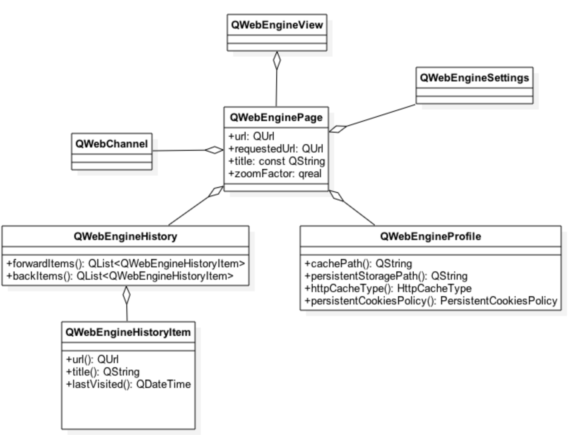
Essential QtWebEngine Classes

Slide 178
QWebEngineView and QWebEnginePage
Allows editing and viewing web content
Functions: load(), setUrl(), setHtml(), setContent(), setPage()
Window management
createWindow() – called, when a new window requested in JavaScript
QWebEnginePage
Run JavaScript: runJavaScript()
Manage permissions: setFeaturePermission()
Trigger action: cut, paste, reload and bypass cache, redo, undo
Authentication: authenticationRequired()

Slide 179
Other Essential Classes
QWebEngineSettings
Font settings
Web attributes: auto load images, JS enabled, local storage enabled, JS can open windows
QWebEngineHistory
Stores the navigation history in history items
Items may be accessed using currentItem(), backItems(), forwardItems()
QWebEngineProfile
Profile shared by multiple pages
Access to settings
Storage path, cache path management
Cache types: memory or disk
QWebChannel
Used to expose QObjects to HTML clients

Slide 180
Handling Asynchronous Functions
Because of two process architecture, some of the web engine functions are asynchronous
Asynchronous functions take a functor or lambda argument
For example, QWebEnginePage allows to convert the web page to HTML or plaint text
void MainWindow::on_pushButton_clicked()
{
QTextBrowser *textBrowser(ui->textBrowser);
m_view->page()->toPlainText([textBrowser](const QString &result) {
textBrowser->setText(result);
});
}

Slide 181
Exposing C++ Functions in WebEngine JavaScript Engine
QWebChannel allows exposing QObject properties, public slots and methods to HTML
Also property updates and signal emissions on the C++ side automatically transmitted to HTML clients
Web channel requires a transport object for the communication between a C++ app and (possibly remote) HTML client
The transport object must implement pure virtual QWebChannelAbstractTransport::sendMessage(const QJsonObject &msg) function – serializes the message and sends it to the client
One solution is to implement the transport object with QWebSocket
Implement sendMessage() using QWebSocket::sendTextMessage();
Emit the transport object messageReceived() signal in the slot, connected to QWebSocket::textMessageReceived() signal
Web channel must be connected to the transport object
Connect a signal with the transport object argument to QWebChannel::connectTo() slot

Slide 182
Exposing C++ Functions in WebEngine JavaScript Engine
// Derives QWebChannelAbstractTransport
void WebSocketTransport::sendMessage(const QJsonObject &message)
{
QJsonDocument doc(message);
m_socket->sendTextMessage(QString::fromUtf8(doc.toJson(QJsonDocument::Compact)));
}
// A slot, connected to QWebSocket::textMessageReceived(const QString &msg) signal
void WebSocketTransport::textMessageReceived(const QString &messageData)
{
QJsonParseError error;
QJsonDocument message = QJsonDocument::fromJson(messageData.toUtf8(), &error);
if (error.error) {
qWarning() << ”Parse error:" << messageData << error.errorString();
return;
}
else if (!message.isObject()) {
qWarning() << "Received JSON message that is not an object: " << messageData;
return;
}
emit messageReceived(message.object(), this);
}

Slide 183
Exposing C++ Functions in WebEngine JavaScript Engine
QWebChannel provides an API to register one or more QObjects
channel.registerObject(QStringLiteral(”myObject”), &object);
In the client side,
Create a web socket and provide callback functions onError(), onClose(), onOpen()
In onOpen(), create a web channel with a web socket and callback arguments
new QWebChannel(socket, function(channel) { } )
Registered objects are available through channel.objects
Essential functionality is provided by qwebchannel.js
The transport object is accessible through navigator.qtWebChannelTransport

Slide 184
Exposing C++ Functions in WebEngine JavaScript Engine
<script type="text/javascript" src="./qwebchannel.js"></script>
window.onload = function() {
var socket = new WebSocket(“ws://127.0.0.1:4321”);
socket.onclose = function() {
console.error(”Channel closed");
};
socket.onopen = function() {
new QWebChannel(socket, function(channel) {
// Access a property
var propertyValue = channel.objects.myObject.propertyX;
// Access a method
channel.objects.myObject.somePublicMethod(propertyValue);
// Access a signal
channel.objects.myObject.someSignal.connect( function() { } );
};
};

Slide 185
Summary
QtWebEngine has replaced QtWebKit for browser functionality mainly because of better
Platform support
Multimedia support
HTML5 support
The web engine provides almost the same set of functionality as the web kit did
Accessing sub-frames and individual web elements in the frames is not supported
Some synchronous functions have been changed to asynchronous
Because of multi-process implementation, the web kit bridge is not supported, but the same functionality (C++ object access in JavaScript) can be accessed using the web channel

Slide 186
Thank You!
www.qt.io

